Slide 1
GAIA’S TOUCH
One touch closer to a better world.

Slide 2
TABLE OF CONTENTS
04
02
05
03
01
Problem Statement
List of Features
Outline of Idea
Google Technologies Used
Addressing the problem statement

Slide 3
Problem Statement
Help increase number of volunteers for social causes by bridging the gap between the common people and the local NGOs aiming to work towards SDGs.

Slide 4
01
Outline Of Idea

Slide 5
Outline of Idea
The proposed application aims to provide a hub-like platform for non-governmental organizations (NGOs) to connect with like-minded people, which, in this specific case, are people who want to work towards sustainable development goals. If we take the SDG of working towards the No Hunger example, this application will help connect the NGOs and parties with surplus food availability, such as restaurants, and caterers and act as an interface to help redistribute surplus food to those in need.

Slide 6
Through this platform, NGOs can efficiently and effectively get, as well as provide help through features such as requesting volunteers, looking through the available resources that might be helpful to them, and even connecting to similar NGOs along with people willing to contribute or donate to help with their cause.

Slide 7
Addressing the problem statement

Slide 8
The application described is a hub that connects NGOs, volunteers, and donors to help achieve Sustainable Development Goals (SDGs). By facilitating connections between these groups, the application helps to address challenges related to funding, availability of resources, workforce, and the interconnected nature of the SDGs. The application promotes collaboration, resource sharing, and a more integrated approach to addressing the SDGs, which can contribute towards achieving these global goals in an uncomplicated, organized and effective manner.

Slide 9
03
Features

Slide 10
Here are some features that Gaia's Touch offers:
User profile creation and management:
Allow users to create profiles with their personal information, skills, interests, and causes they care about.
Search functionality: Enable users to search for NGOs, projects, and initiatives related to the SDGs that they are interested in supporting.
Project and initiative listing: Allow NGOs to create listings for projects and initiatives related to the SDGs, detailing their goals, objectives, and desired outcomes.

Slide 11
Volunteer recruitment: Allow NGOs to post volunteering opportunities that match the skills and interests of potential volunteers. Users can browse through the opportunities and apply for them.
Donation management: Allow users to donate to NGOs and their projects related to the SDGs through the application. It should provide a secure payment gateway and keep a record of all transactions.
Messaging and communication: Allow users to communicate with NGOs, volunteers, and other parties interested in the SDGs to collaborate, ask questions, and share ideas.

Slide 12
Event creation and management: Allow NGOs to create events such as fundraisers, webinars, and other activities to promote their initiatives and engage with their supporters.
Progress tracking: Allow NGOs to update their progress on their projects and initiatives related to the SDGs, which can help build trust and transparency with their supporters.
Analytics and reporting: Provide analytics and reporting features to NGOs to help them understand their user base, track their progress, and optimize their outreach efforts.
Multi-language support: Provide support for multiple languages to ensure that the application is accessible to a global audience.

Slide 13

Google Technology used
Flutter
Google cloud services
firebase
Google Sheets
Google pay
Google Analytics

Slide 14
TECHNOLOGIES WE HAVE USED:-
User profile creation and management: Use Google Firebase Authentication to allow users to create accounts and manage their profiles. Firebase Authentication provides a simple and secure way to authenticate users and manage user accounts.
Volunteer recruitment: Use Google Forms to create forms that NGOs can use to collect information from potential volunteers. Google Forms provides a simple and powerful way to create forms that can be easily integrated into the application.

Slide 15
Messaging and communication: Use Google Cloud Services to implement a messaging system that allows users to communicate with NGOs, volunteers, and other parties interested in the SDGs. Google Cloud Pub/Sub provides a scalable and reliable messaging system that can be easily integrated into the application.
Progress tracking: Use Google Sheets to track and update progress on projects and initiatives related to the SDGs. Google Sheets provides a flexible and powerful way to manage and analyze data.

Slide 16
Analytics and reporting: Use Google Analytics to track user behavior and analyze user data. Google Analytics provides a powerful and easy-to-use analytics platform that can be easily integrated into the application.
Further, we use Flutter by GOOGLE to develop Gaia's Touch in the first place.

Slide 17
TECHNOLOGIES WE ARE PLANNING TO IMPLEMENT IN FUTURE.
Search functionality: Use Google Cloud Search to implement a search engine that allows users to search for NGOs, projects, and initiatives related to the SDGs. Google Cloud Search provides a powerful search capability that can be easily integrated into the application.
Donation management: Use Google Pay to implement a secure payment gateway that allows users to donate to NGOs and their projects related to the SDGs. Google Pay provides a simple and secure way to process payments.

Slide 18
Multi-language support: Use Google Cloud Translation to provide multi-language support for the application. Google Cloud Translation provides a powerful and easy-to-use translation service that can be easily integrated into the application.
Event creation and management: Use Google Calendar to create and manage events such as fundraisers, webinars, and other activities to promote NGOs and engage with their supporters. Google Calendar provides a powerful and easy-to-use calendar management system that can be easily integrated into the application.

Slide 19
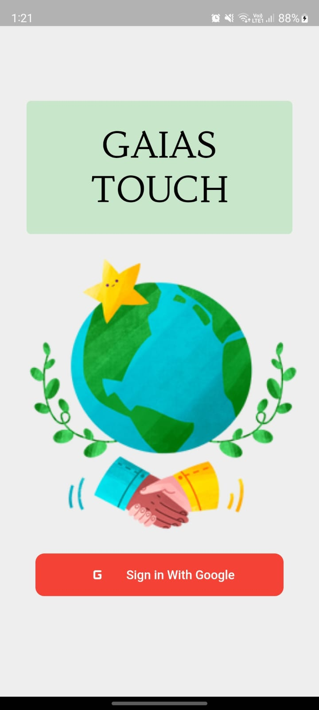
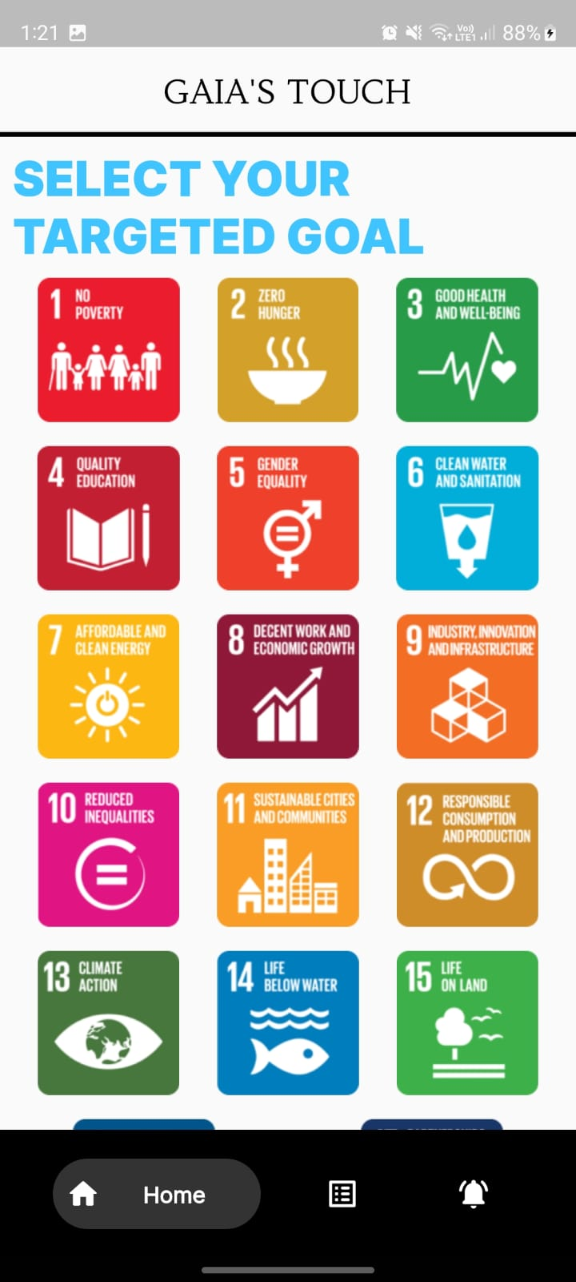
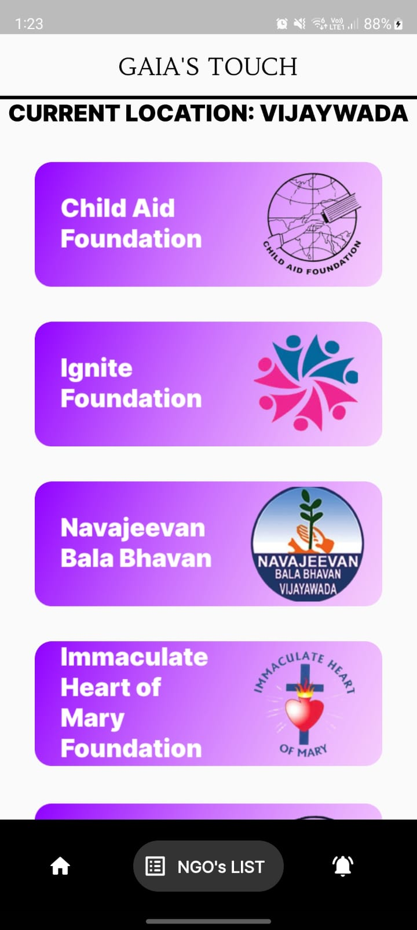
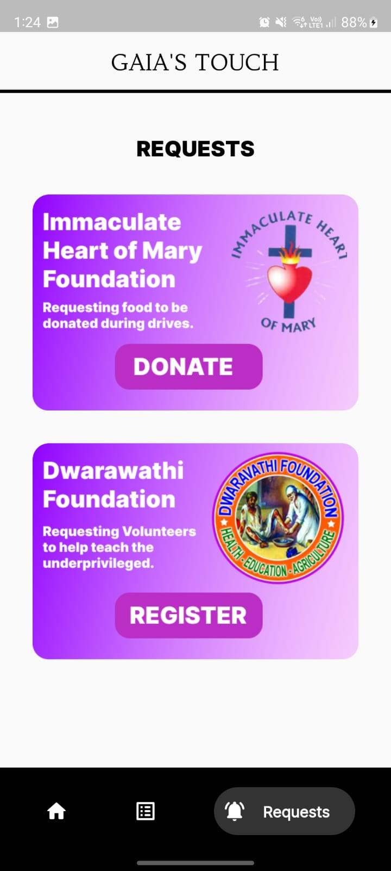
ScreenShots from our APP
Login Page

Slide 20
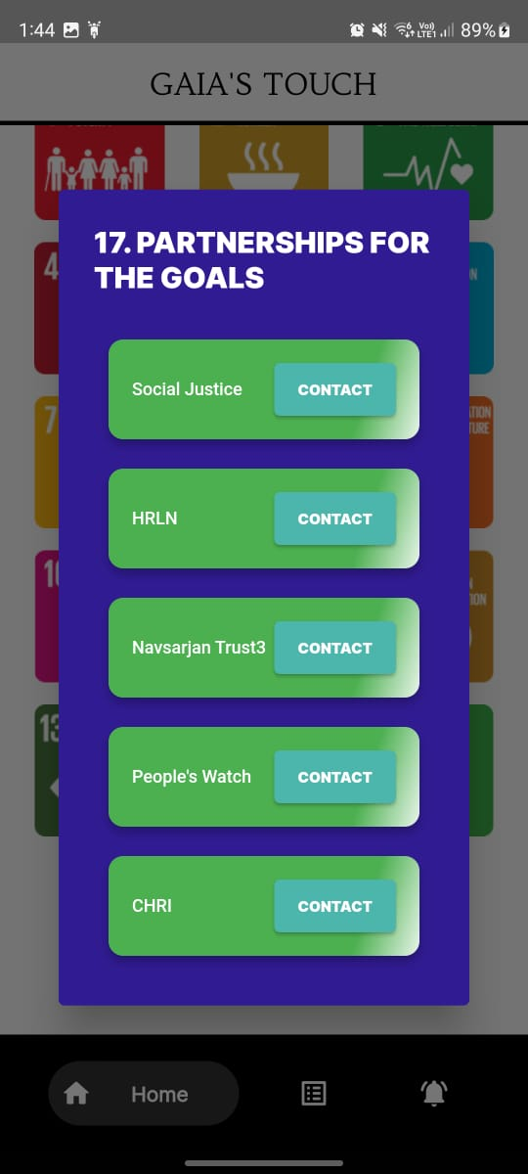
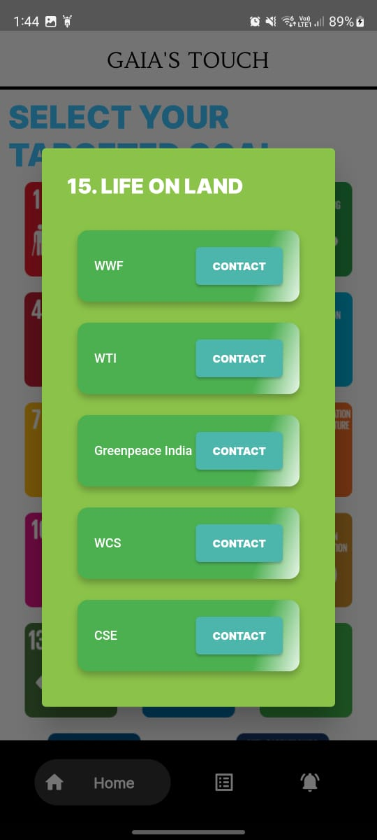
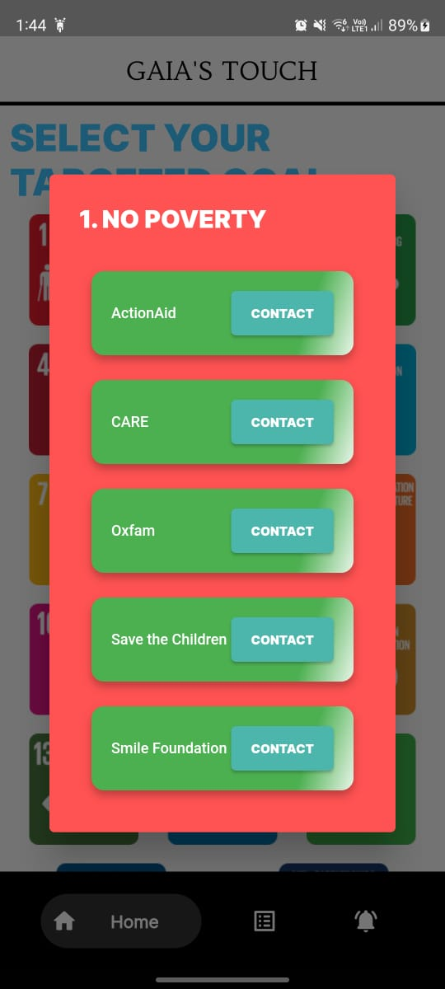

Slide 21
OUR TEAM
Radha Krishna Garg
Md. Anas Jamal
Aryan Gupta

Slide 22
THANKS!
DO YOU HAVE ANY QUESTIONS?

